Slide 1
INTRO TO HTML
MCNDHS
Ms. Eng

Slide 2
AIM: Line breaks and Abbreviations
Do now:
Daily Grade:
On-time/attendance/not leaving the classroom: 25%
Cellphones: 25%
Notes:25%
Classwork/Homework: 25%

Slide 3

LINE BREAKS HORIZONTAL RULE

Slide 4

LINE BREAK/HORIZONTAL RULE
Line break: <br> **NO CLOSING TAG**
Horizontal rule: <hr> **NO CLOSING TAG**

Slide 5


ABBREVIATIONS AND ACRONYMS
<abbr title=“ INSERT YOUR DEFINITION HERE “> insert acronym</abbr>
Example:

Slide 6
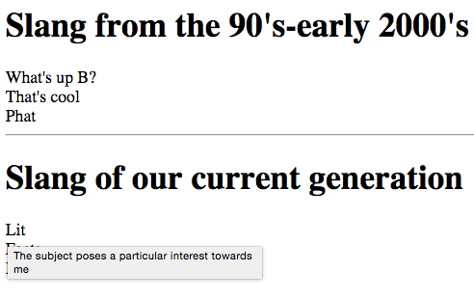
ACTIVITY
Create two lists of slang from two generations with the abbreviations

